Slide 1
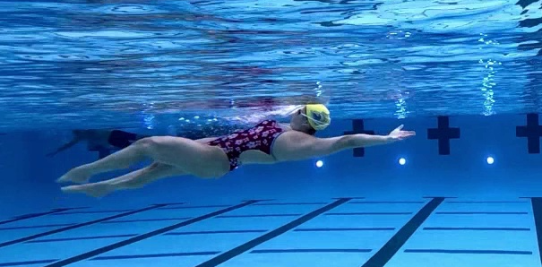
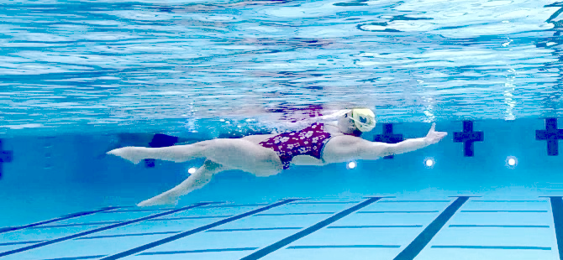
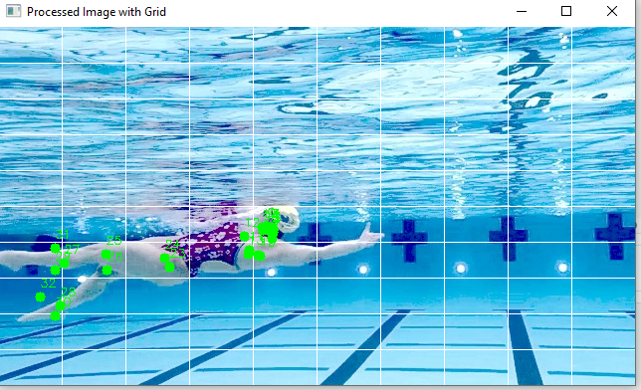
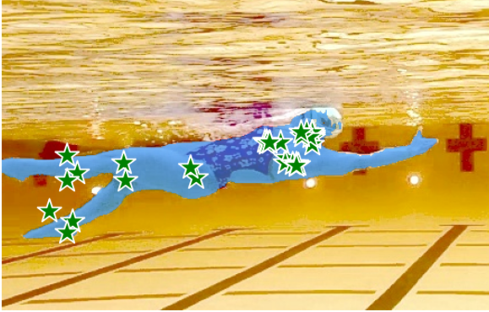
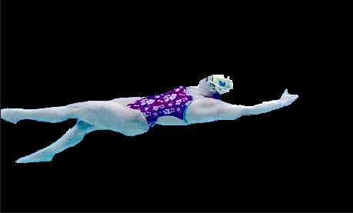
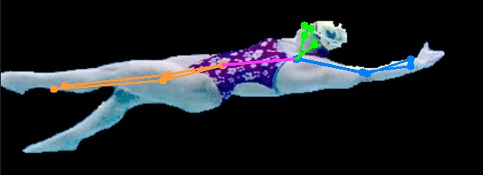
General Overview of Image Processing Pipeline
1. Extract Images
2. Enhance Image
Numbers 1 – 6 display the general pipeline of image processing used to execute the task.
Each image is extracted and enhance as preprocessing to be sent MediaPipe neural network.
The main use of using MediaPipe is to locate where in the enhanced image the swimmer might be in frame.
The YOLOv7 provided critical key-points data found for the segmented swimmer to be used for training.
3. MediaPipe Object Location
4. SAM Segmentation
5. Overlay Segmented Swimmer
6. Run Pose Estimation Using YOLOv7

